Slide 1

Web project

Slide 2
Presentation steps
Group presentation
01
-Members of the team
Project presentation
02
-Type of users
-Trello
-W3C
-Price of web hosting
Demo
03
We will show you the site on different platforms
Conclusion
04
-improvement points

Slide 3
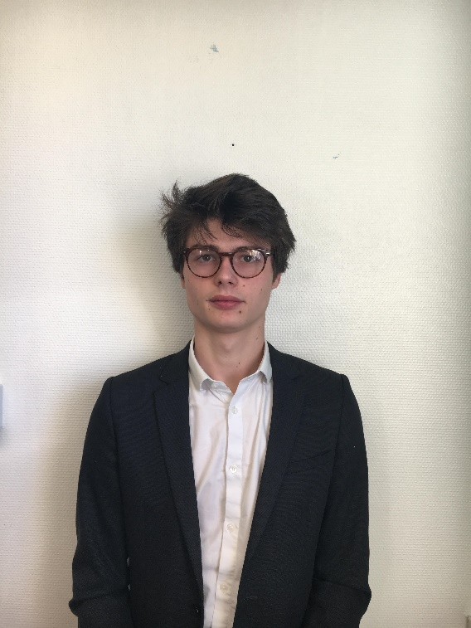
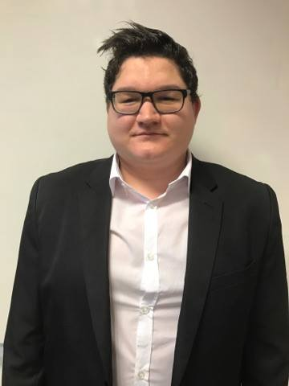
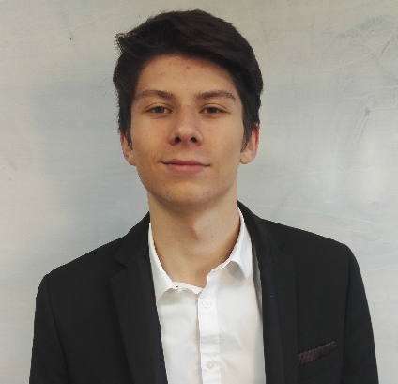

Group presentation
Insert the title of your subtitle Here
Paul
BOOGAERTS
Florian
FRITCH
Anthony
DESCAMPS
Aurélien
KLEIN
Dev back end
Dev back end
Dev front end
Dev Back end
Architect BDD
Project
Manager

Slide 4
Project presentation

Slide 5
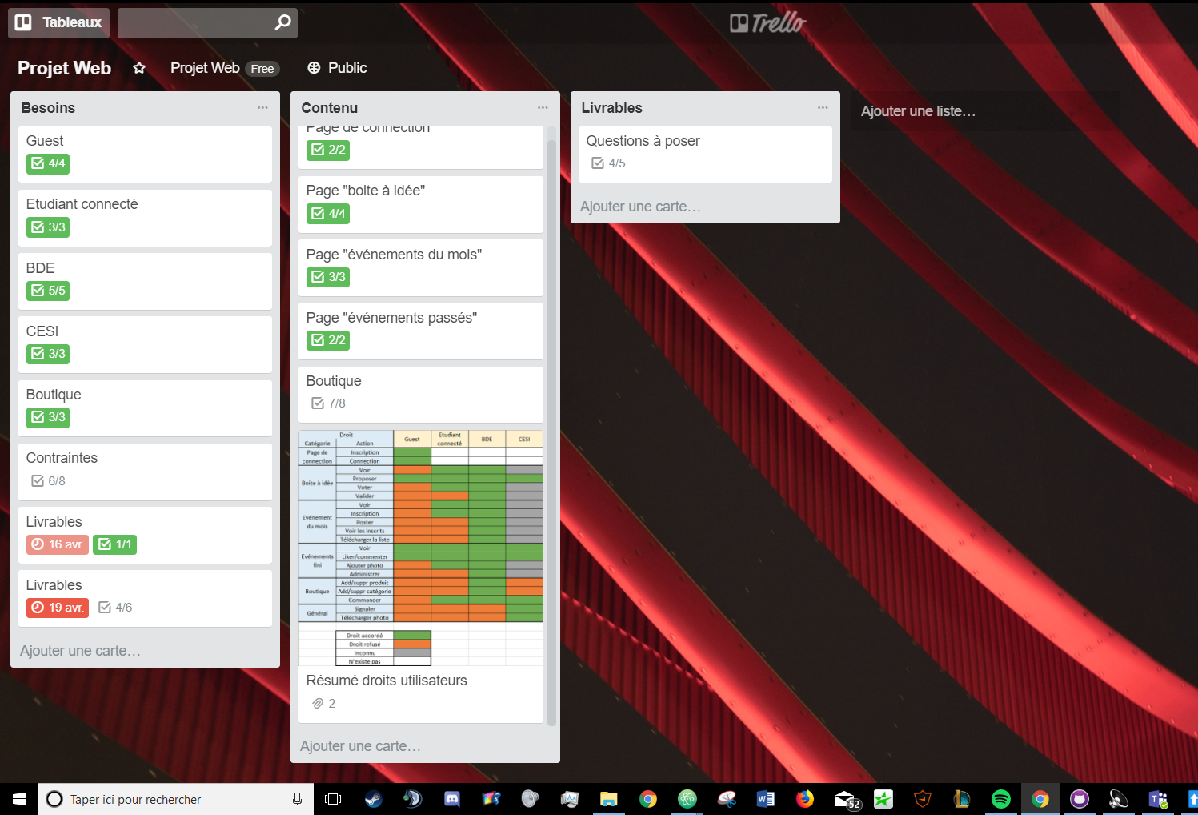
Trello Features
Online project tools
We use trello to simplify tasks management. We save lot’s of time in working time. It’s easily to work for the project manager.

Slide 6
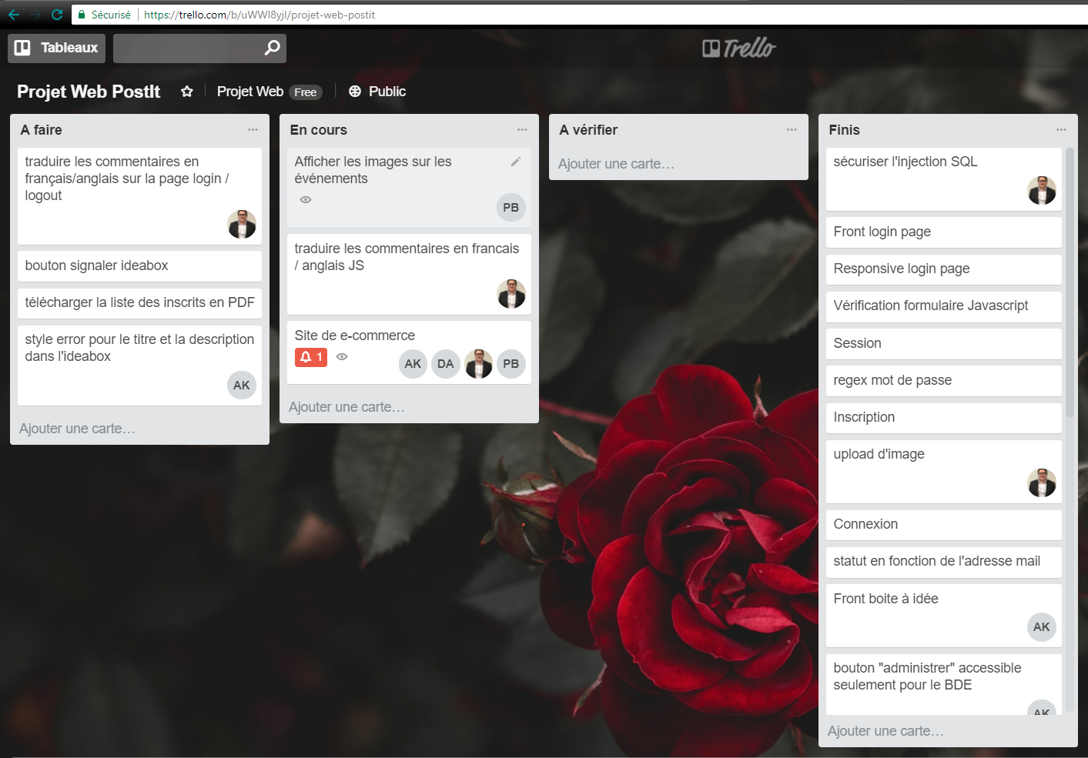
Trello tasks
To do
01
What we need to do
On going
02
What we are doing
Done
03
What we have done

Slide 7
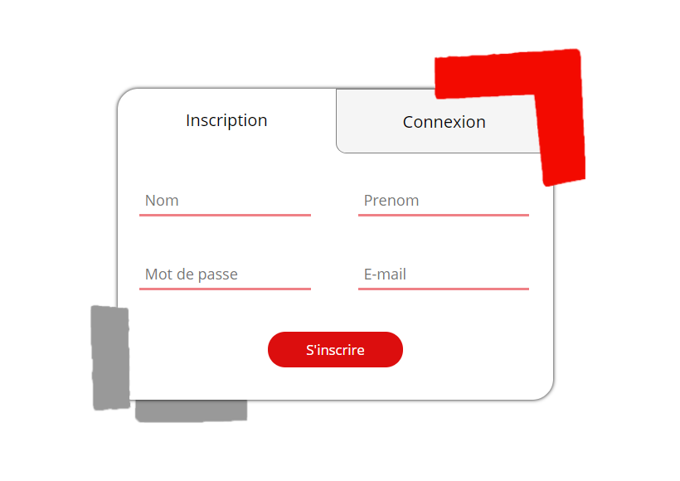
Type of users
Not Connected
01
They c’ant have acces to the site
Connected
They can go on the site but not administrate the site
02
BDE members
They can go on the site and administrate publications
03
Cesi employees
They can go on the site, report publications and administrate account
04

Slide 8
SEO
Code
The first step is to take care of your code
Google
Tell Google that you exist
Advertising
Show yourself to the world

Slide 9

Hosting cost
How much for your site ?
OVH Kimsufi Web
$2.00
OVH Perso
$4.00
OVH Pro
$8.00
OVH Performance
$12.00

Slide 10
Demonstration

Slide 11
Conclusion

Slide 12

Improvement points
Manage quantities
Sale Email
We can’t manage de quantity of a product in the shop
Send an automatic Email to the BDE after a sale
Auto completion
Email account
Create an auto completion system for the search bar in the shop
Send an Email to validate the account after the registration

Slide 13

Conclusion
01
All functionalities have done
02
More time would have been better
Functional model
03
Cesi employees
04

Slide 14

Questions

